Slide 1
Room Manager Project presentation
AYUB YUSUF
SDET programme (Software development engineer in test)

Slide 2
Project Objective
Build a full-stack web application which is fully CRUD functional
The chosen business case:
Room management system
The project must be rigorously tested (e.g. Junit, Mockito, Selenium)
Due to lack of time, the focus of the project was on the Minimum Viable Product (MVP)

Slide 3
Technologies used
Agile & Project Management:
Jira Kanban board
Risk Assessment
Databases & Cloud Fundamentals:
MySQL
Programming Fundamentals:
Java
Front-End Web Technologies:
HTML
CSS
Javascript
Notes:
In addition:
Must be able to calculate the cost of an order (done in java)
ADD/DELETE items in orders

Slide 4
Technologies used
API Development:
JSON
Automated Testing:
Junit
Mockito
Selenium
Version Control System:
Git
Source Code Management:
GitHub
Notes:
In addition:
Must be able to calculate the cost of an order (done in java)
ADD/DELETE items in orders

Slide 5
Scope
A risk assessment which outlines the issues and risks faced during the project timeframe
Code fully integrated into a Version Control System
A project management board
A relational database used to persist data for the project
A functional application back-end
A functional ‘front-end’ website which connects to your back-end API
A build of the application
Unit tests for validation of the application

Slide 6
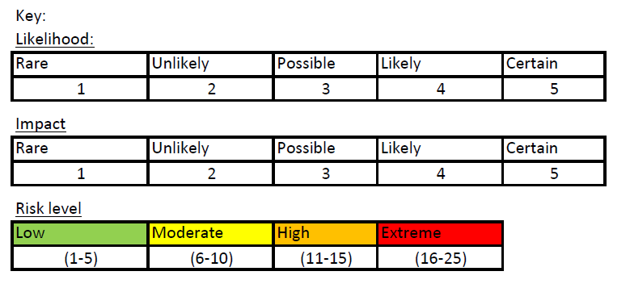
Risk Assessment
Notes:
Likelihood of a risk happening is given a scale from 1 – 5
Impact of a risk also given scale 1 – 5
Risk level is both multiplied

Slide 7
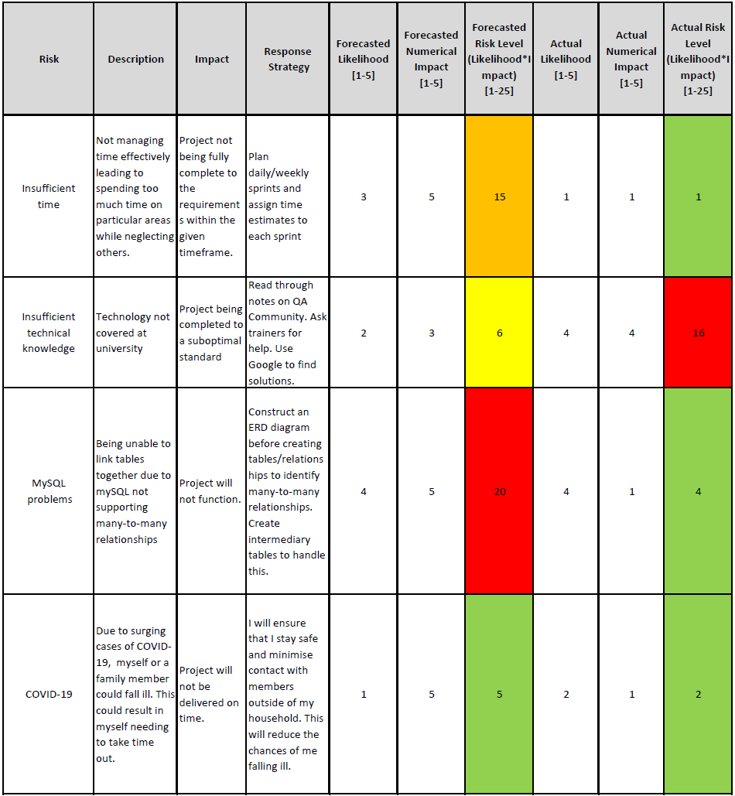
Risk Assessment

Slide 8
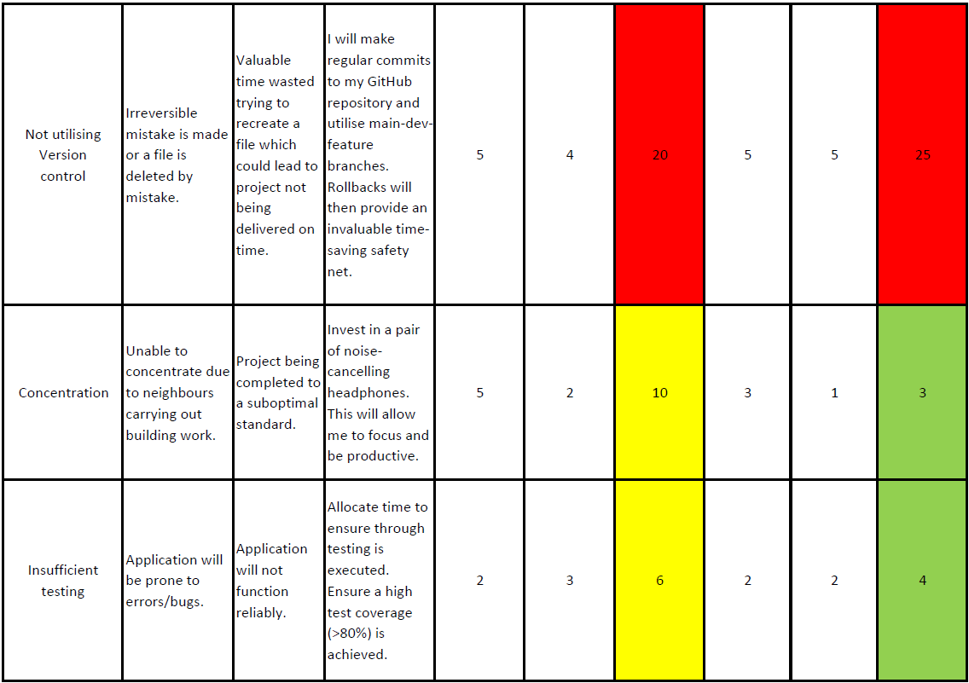
Risk Assessment

Slide 9
Scope
A risk assessment which outlines the issues and risks faced during the project timeframe
Code fully integrated into a Version Control System
A project management board
A relational database used to persist data for the project
A functional application back-end
A functional ‘front-end’ website which connects to your back-end API
A build of the application
Unit tests for validation of the application

Slide 10
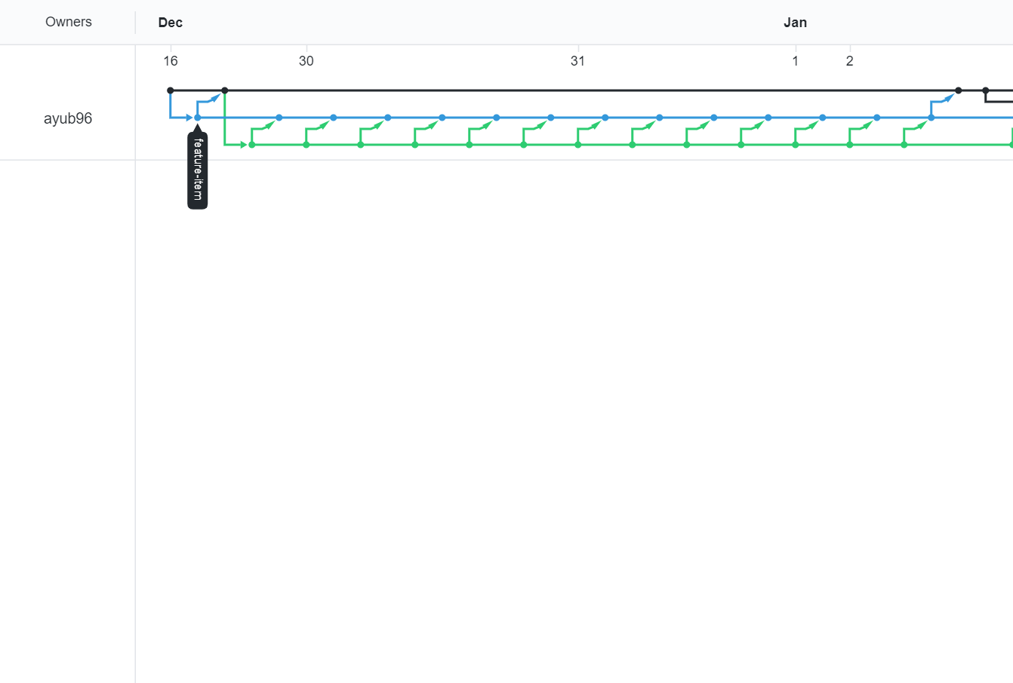
Version control system: Git
Main branch
Developer branch
Feature CRUD branch
feature-branch model: master/dev/multiple features
Notes:
- feature-branch model: master/dev/multiple features

Slide 11
Scope
A risk assessment which outlines the issues and risks faced during the project timeframe
Code fully integrated into a Version Control System
A project management board
A relational database used to persist data for the project
A functional application back-end
A functional ‘front-end’ website which connects to your back-end API.
A build of the application
Unit tests for validation of the application

Slide 12
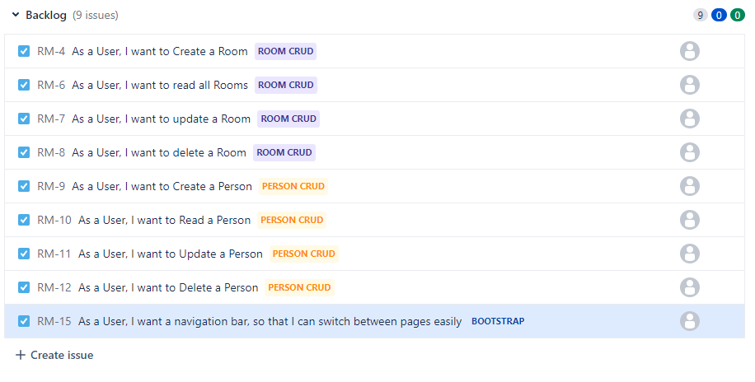
Project management board: Kanban
To effectively manage my project, an Agile approach was adopted.
A Kanban board (a feature of Jira) was used to manage the project.
The first step of the planning was to add an exhaustive list of user stories to the backlog.

Slide 13
Sprint review
Most of the Sprints were completed successfully, though some were left behind due to difficulty or lack of time:
Customer email
Orderline feature:
Multiple items with the same id can be contained in one line in an order

Slide 14
Scope
A risk assessment which outlines the issues and risks faced during the project timeframe
Code fully integrated into a Version Control System
A project management board
A relational database used to persist data for the project
A functional application back-end
A functional ‘front-end’ website which connects to your back-end API.
A build of the application
Unit tests for validation of the application

Slide 15
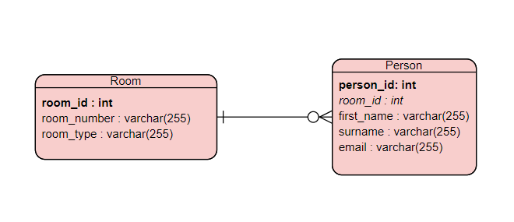
Relational database: MySQL
The above ERD diagram was implemented in the relational database
Notes:
- The database management system used was MySQL
- Speak in detail

Slide 16
Scope
A risk assessment which outlines the issues and risks faced during the project timeframe
Code fully integrated into a Version Control System
A project management board
A relational database used to persist data for the project
A functional application back-end
A functional ‘front-end’ website which connects to your back-end API.
A build of the application
Unit tests for validation of the application

Slide 17
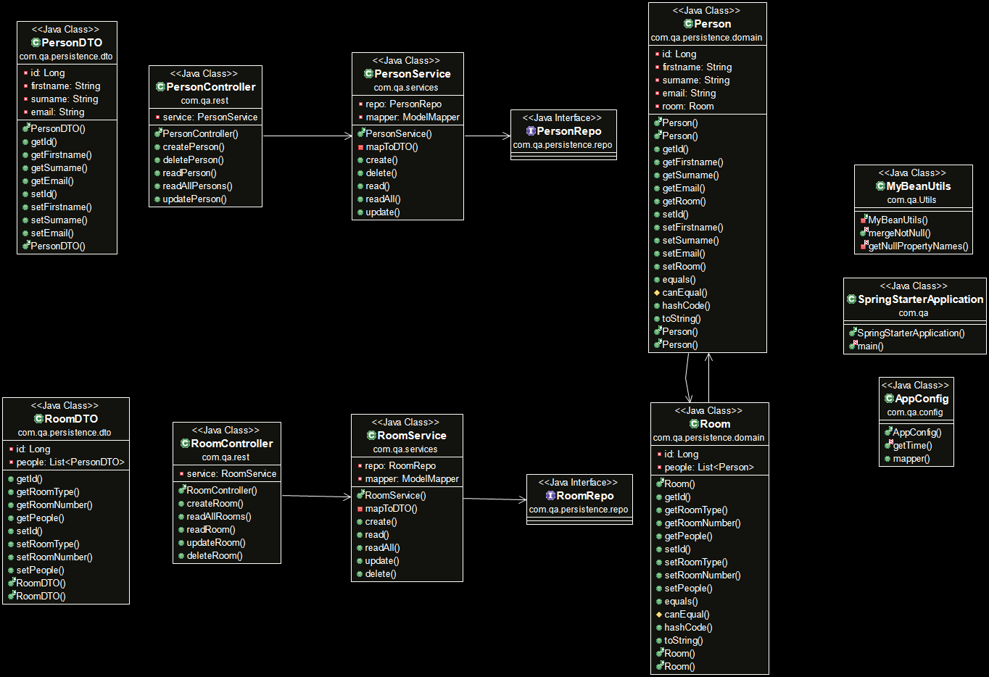
Back-end: Java
Good practices and design principles were followed:
The Spring framework was used for the back end
Notes:
Highlight the fact that the IMS speaks to the CrudController interface
The Controllers speak to the DAO interface

Slide 18
Scope
A risk assessment which outlines the issues and risks faced during the project timeframe
Code fully integrated into a Version Control System
A project management board
A relational database used to persist data for the project
A functional application back-end
A functional ‘front-end’ website which connects to your back-end API
A build of the application
Unit tests for validation of the application

Slide 19
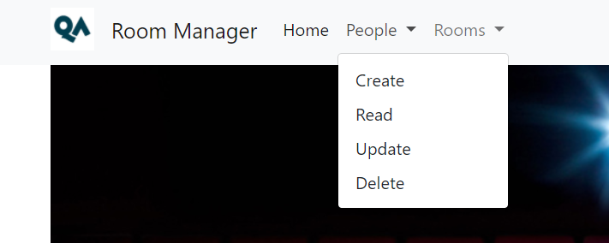
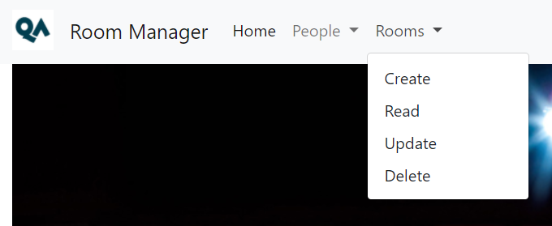
CRUD functionality following the Enterprise Architecture Model

Slide 20
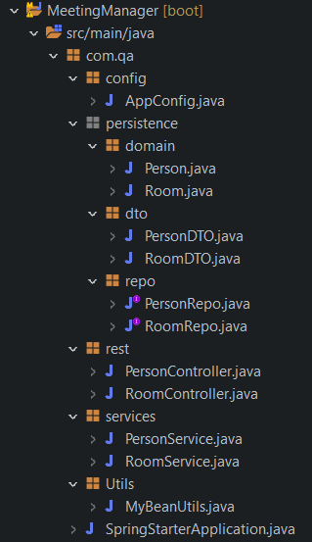
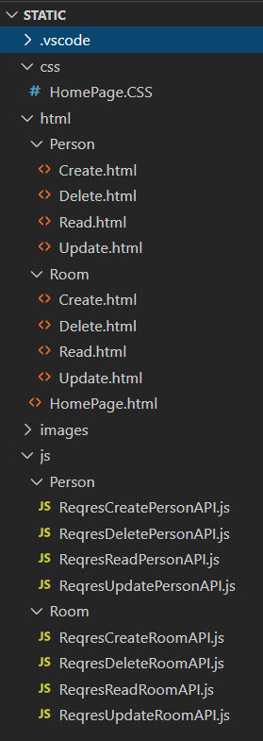
Package structure
Back-end
Front-end

Slide 21
Scope
A risk assessment which outlines the issues and risks faced during the project timeframe
Code fully integrated into a Version Control System
A project management board
A relational database used to persist data for the project
A functional application back-end
A functional ‘front-end’ website which connects to your back-end API.
A build of the application
Unit tests for validation of the application

Slide 22
Scope
A risk assessment which outlines the issues and risks faced during the project timeframe
Code fully integrated into a Version Control System
A project management board
A relational database used to persist data for the project
A functional application back-end
A functional ‘front-end’ website which connects to your back-end API.
A build of the application
Unit tests for validation of the application

Slide 23
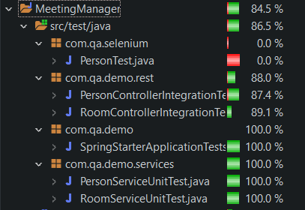
Unit and Integration testing for Back-end
Both Unit and Integration tests were performed.
Overall test coverage of 84.5% was achieved

Slide 24
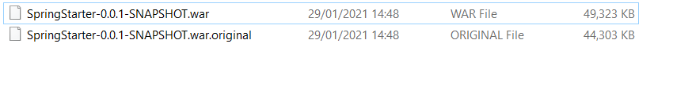
Build of application: Maven
The application was built using the build tool Maven.
A .war file was created which can be deployed from the command line

Slide 25
Conclusion/Sprint Review
Better commits should be used, eg “feature-customer-crud”
Commits should be made regularly to avoid dumping lots of changes in one go
Utilise Jira Kanban board more:
User stories should continuously be added to the backlog throughout the project timeline so it is clear what is left to be done when new user stories surface

Slide 26
Questions?

